Slide 1
CITIPRIMEBROADCASTING Escalate Your Dream

Slide 2
ABOUT CITIPRIMEBROADCASTING
CITIPRIMEBROADCASTING is one of the largest brand implementation partners in the industry. We do this through our national signage, maintenance and construction offerings. We craft the visionary bridge between your brand identity and your customer’s experience. we have evolved our business to combine traditional craftsmanship and innovation into every branded element and space we touch. From engineering large scale high rise spectacular signage to utilizing our LED retrofit efficiencies, it is Creative Signplus’s goal to be your single source and turnkey resource for all of your signage manufacturing, maintenance and construction needs.

Slide 3
DIGITAL SIGNAGE
Digital signage means using digital displays to deliver rich media content to a public audience.
Each display is connected to the network via media player and can show anything
from corporate communications to video and multimedia presentations.

Slide 4
Planning for Digital Signage
What is involved
Bussiness
ROI
Partnership
Revenue
Content
Media
Advertising
Marketing
Operations
Installation
Network
Maintenance
Connectivity
Wired
Wireless
Cellular
internet
Design
Deployment
Purpose
Environment
DIGITAL
SIGNAGE
Hardware
Displays
Mounts
Players
Infrastructures
Operations
Installation
Network
Maintenance

Slide 5
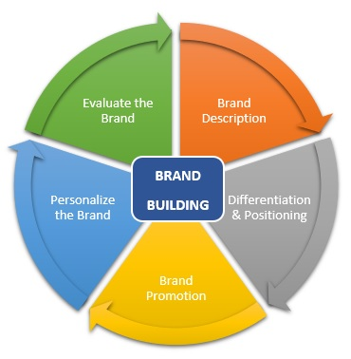
BRAND BUILDING
Digital signage serve as an effective & efficient marketing tool for building brand image among customer.

Slide 6
5 BENEFITS OF RETAIL DIGITAL SIGNAGE
IMPROVE COMMUNICATION
Personalized messages that appeal to your specific audience works wonders. Create content that caters to the time of the day, peak hours, sales promos, etc.
DRIVE NEW SALES
Focus interest on exclusive special in-store offers. Promote new sales and BOGO’s. Include educational product videos that build value while driving sales!
INFLUENCE PURCHASING
Deliver ads to right people at the right time! The content can be set to change in real-time based on the audience that is viewing the screen.
IMPROVE SHOPPING EXPERIENCE
Share customer-centric notifications, store hours, and wayfinding maps making it easier for customer to locate products.
SOCIAL PROOF
Showcase customer testimonials with images your shoppers will be able to know the positive comments and outstanding service you have been providing

Slide 7
5 REASONS TO USE DIGITAL SIGNAGE
63 %
More people say that digital signage catches their eyes
90 %
Saving with quicker uploading of new messages
200 %
Increase in audience relation rate
30 %
Increase in sales when using digital signage
60 %
Buying decisions are made at the point of sale

Slide 8
THANK YOU

